Slide 1
Learning from Chagas disease: Hepatitis C Access challenges
Breakout session of Chagas Coalition for Operational Research on NTDs
(COR-NTD)
Graciela Diap, MD
7 October 2020

Slide 2
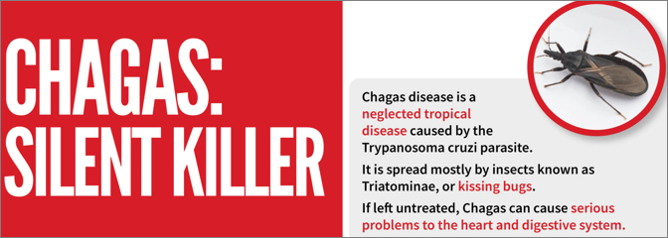
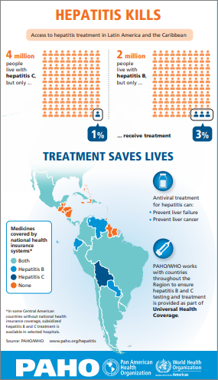
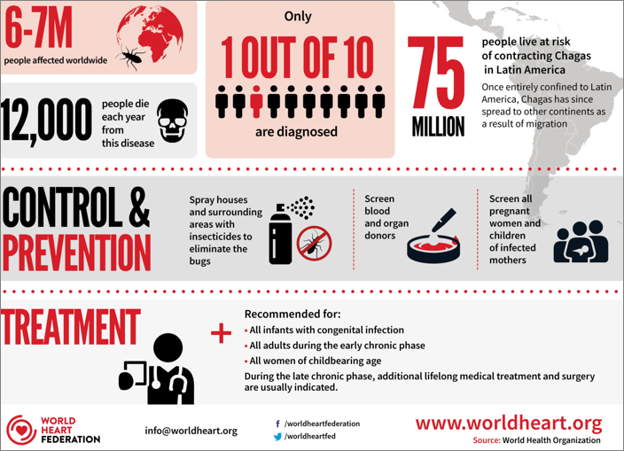
The problem
Silent diseases, low treatment rates, neglected patients and social challenges

Slide 3
The challenges
Similar multidimensional barriers to treatment access for
Chagas disease and hepatitis C
Systemic
- Regulatory obstacles for drugs and tests
- Disruptions to medication supplies
- Lack of routine screening
- Low provider disease awareness
- Weak health education
Structural
- Low access to health services
- Unaffordability of tests and medications
- Income disparities
- Immigration status
- Employment concerns
Psychosocial
- Fear
- Stigma
- Isolation
- Exclusion
- Inequality
- Discrimination
Clinical
- Low detection rate
- Lack of knowledge of clinical guidelines
- Unavailability of medications
- Difficulties with diagnosis
Barriers

Slide 4
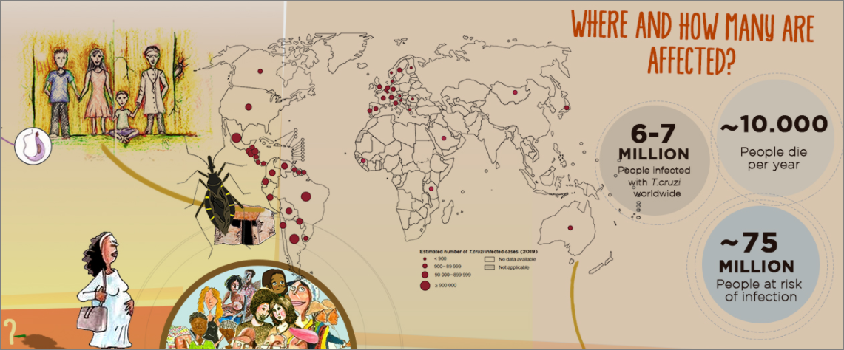
The PROBLEM
Chagas disease & hepatitis C can be transmitted from mother to child, by infected blood transfusion and organ transplantation

Slide 5
The way forward
Treatments for Chagas disease and for hepatitis C exist, but how will doctors find the people who need them?
Increase provider disease awareness
Foster publicity and public health education
Implement routine, active screening
Hepatitis C: Hunting the silent killer
Simplified, decentralized, integrated models of care (MTCT, PHC, community clinics, HIV coinfected, PWID, MSM, etc.)
→ Public leadership and investment in health
Illustration by Sara Andreasson

Slide 6
with the support of STARR International Foundation
& Fondation Arpe (Switzerland)

